Slide 1



Noida Institute of Engineering and Technology, Greater Noida
OP -AMP AND ELECTRONICS INSTRUMENTATION
UNIT-5
Basic Electrical and Electronics Engineering
Kashika Baranwal
Assist. Professor
NIET, Gr. Noida
B Tech 1st/2nd Sem

Slide 2
Content
OPERATIONAL AMPLIFIERS
Introduction
Op-Amp Basic
Practical Op-Amp Circuits
Inverting Amplifier,
Non-inverting Amplifier
Summing Amplifier
Integrator
Differentiator
Electronic Instrumentation
Digital Multimeter (DMM)
Sensors
Types of sensor
Introduction to IoT and its application.

Slide 3
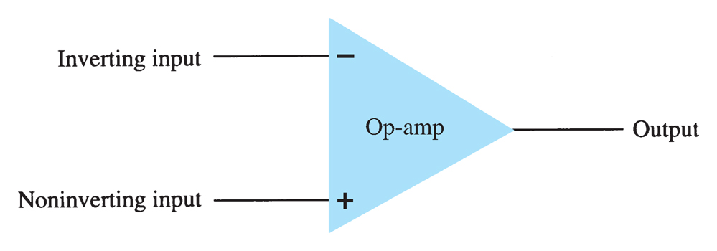
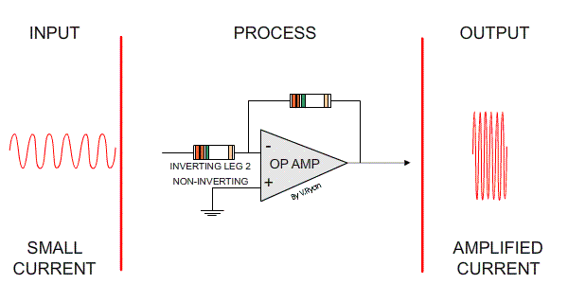
Introduction (CO5)
It performs different types of Mathematical Operations
A high gain differential amplifier with a high input impedance (typically in MΩ) and low output impedance (less than 100Ω)

Slide 4
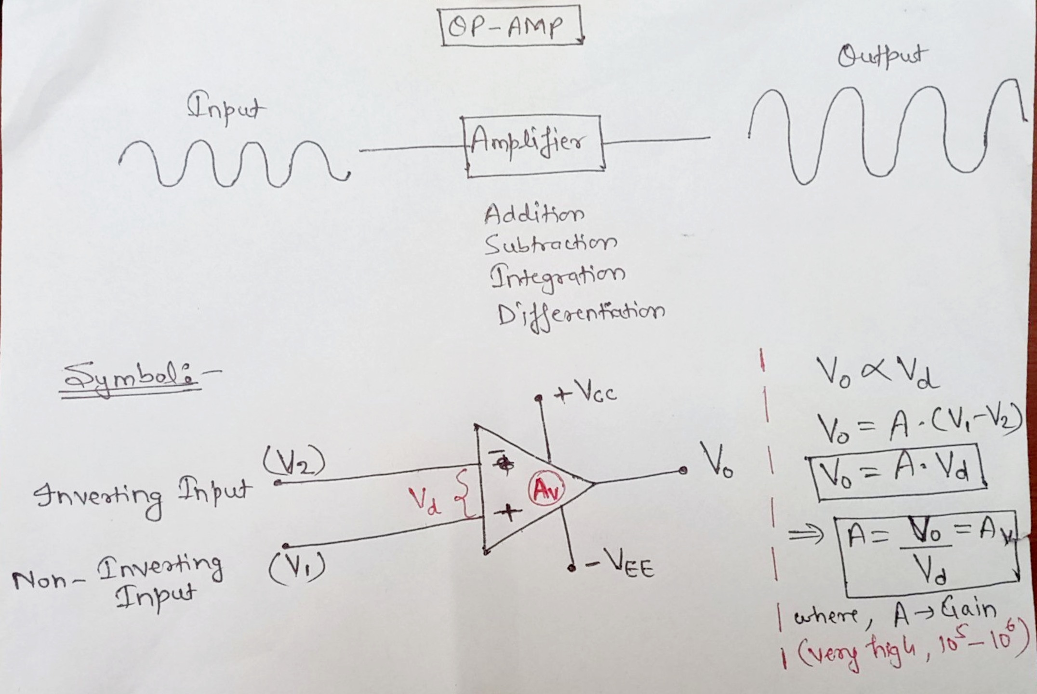
Non-inverting Amplifier (CO5)

Slide 5
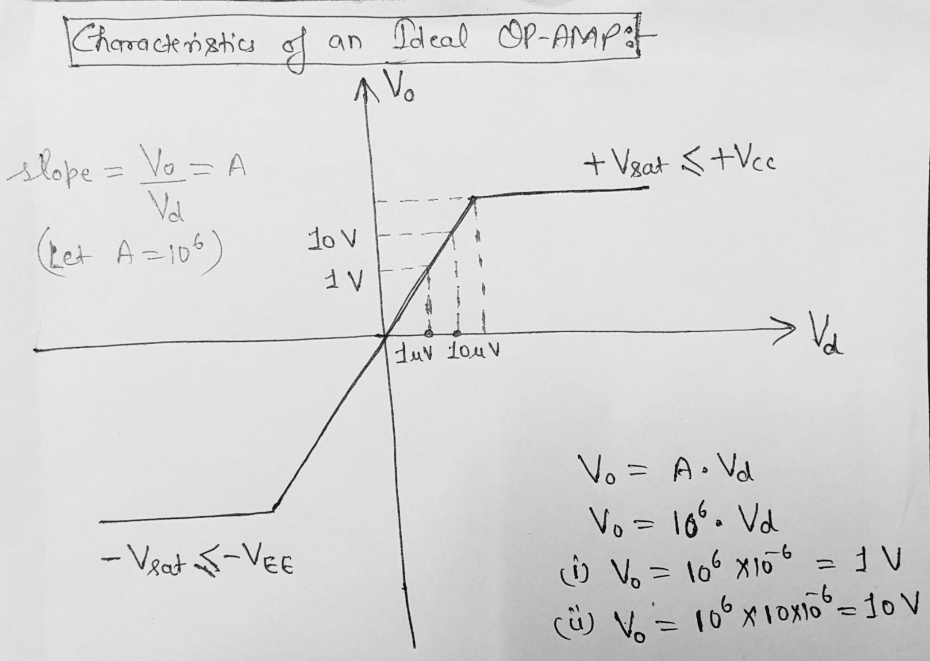
Characteristics

Slide 6
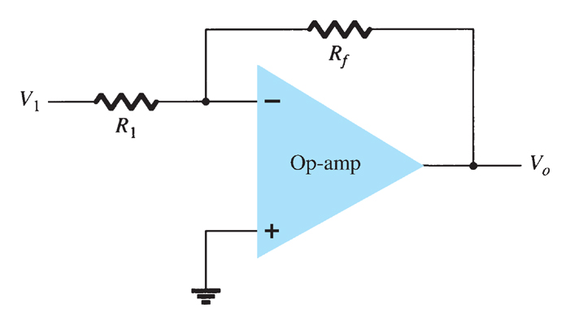
Inverting Amplifier(CO5)
The closed loop Gain
Gain can be set to any value by manipulating the values of R_{f} and R₁.
The negative sign denotes a 180° phase shift between input and output.

Slide 7
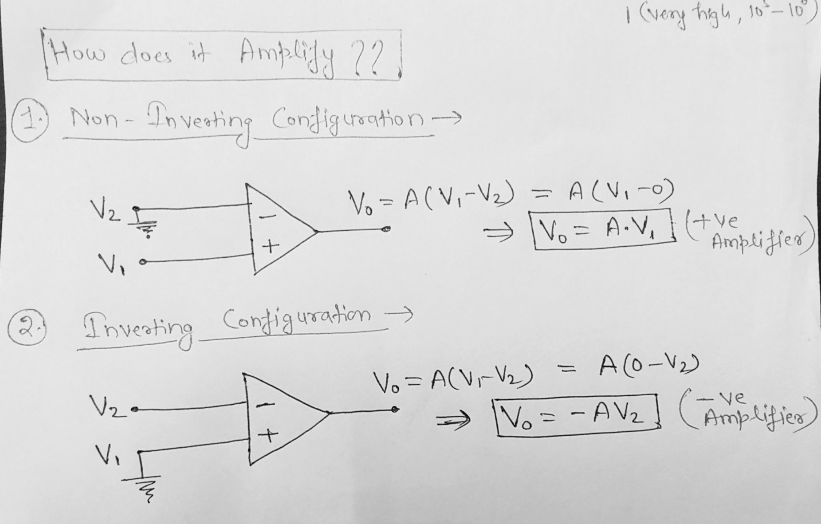
Non-inverting Amplifier (CO5)

Slide 8
Introduction (CO5)
It performs different types of Mathematical Operations
A high gain differential amplifier with a high input impedance (typically in MΩ) and low output impedance (less than 100Ω)

Slide 9
Inverting Amplifier(CO5)
The closed loop Gain
Gain can be set to any value by manipulating the values of R_{f} and R₁.
The negative sign denotes a 180° phase shift between input and output.

Slide 10
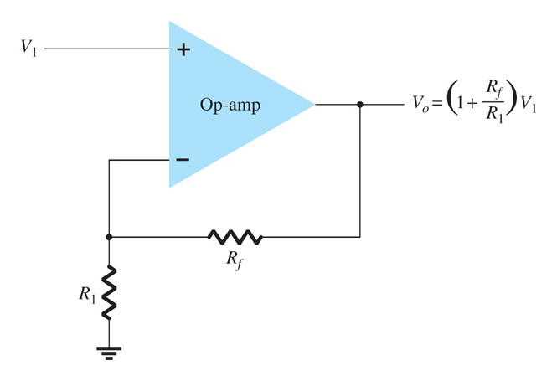
Non-inverting Amplifier (CO5)
The positive sign denotes that input and output are in same phase.

Slide 11
Characteristics

Slide 12
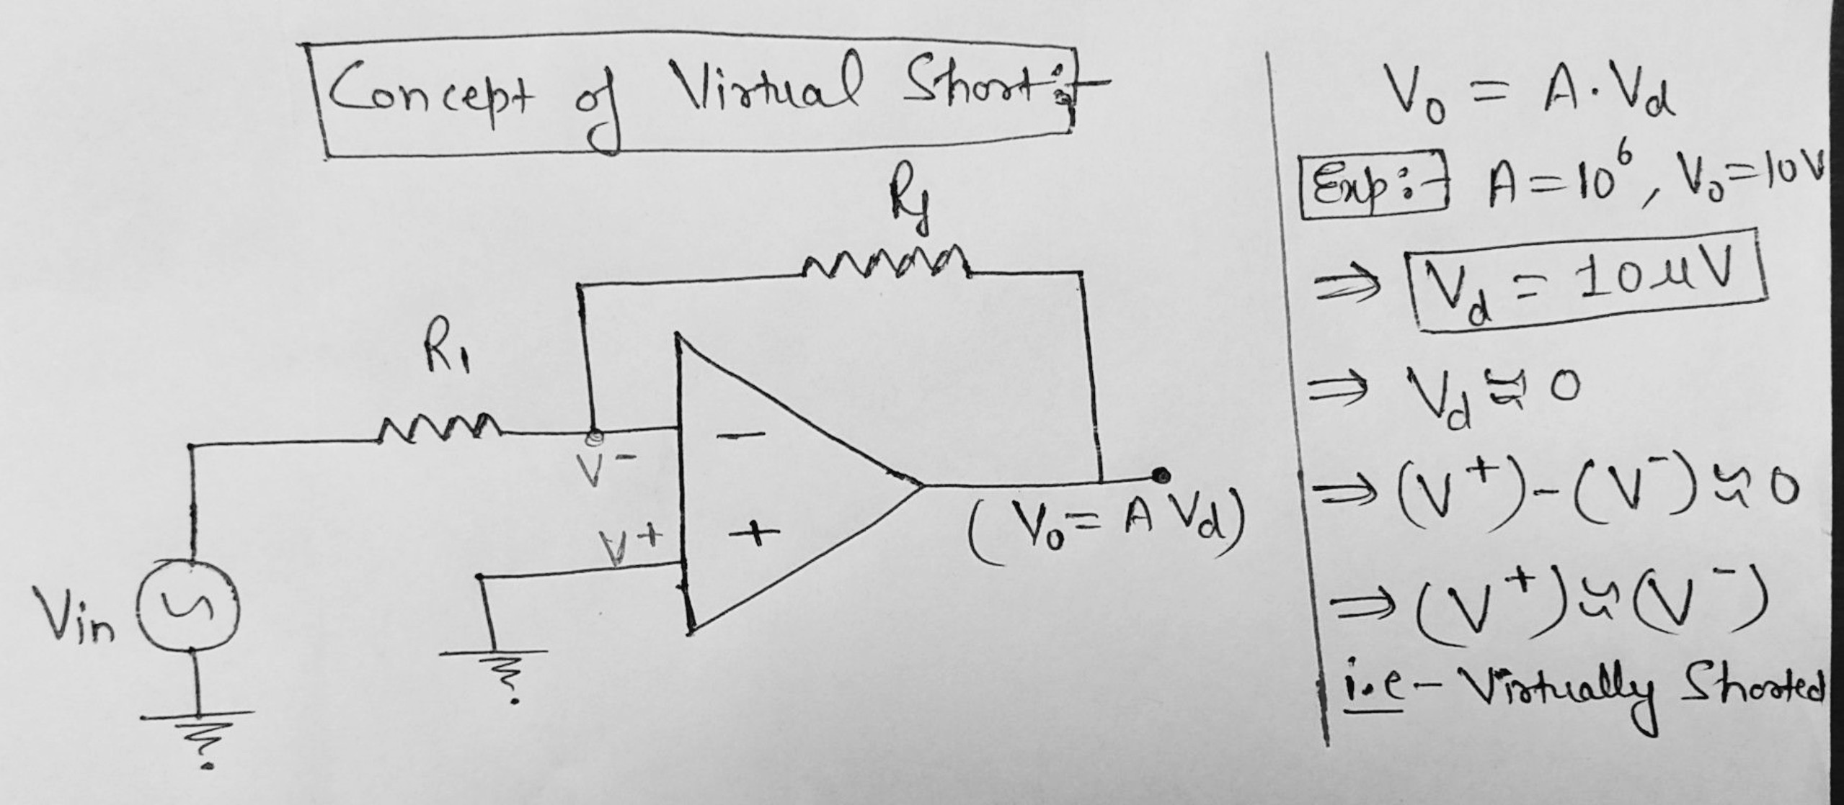
Virtual Short

Slide 13
Ideal Vs Practical parameters of Op-Amp (CO5)
Parameters | Ideal | Practical
Open Loop Voltage Gain | ∞ | 20,0000
Input Impedance | ∞ | 2 MΩ
Output Impedance | 0 | 75 Ω
Input offset voltage | 0 | 2 mV
Input offset current | 0 | 20 nA
Input bias current | 0 | 80 nA
Bandwidth | ∞ | 1 MHz
CMRR | ∞ | 90dB
Slew Rate | ∞ | 0.5 V/μ-sec

Slide 14
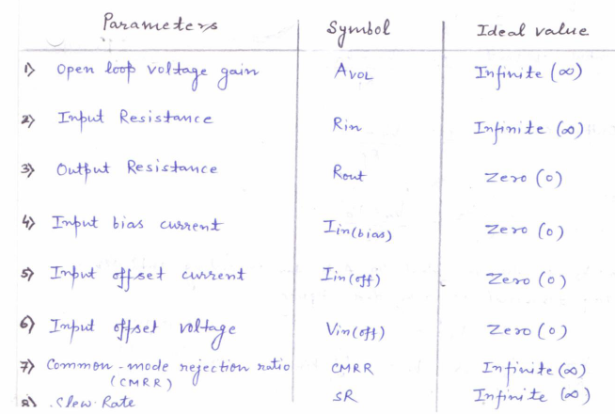
Characteristics of Ideal OP-Amp

Slide 15
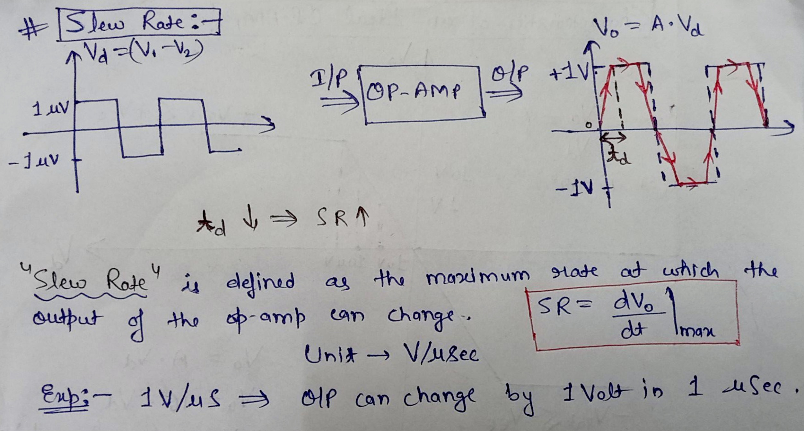
Slew Rate

Slide 16
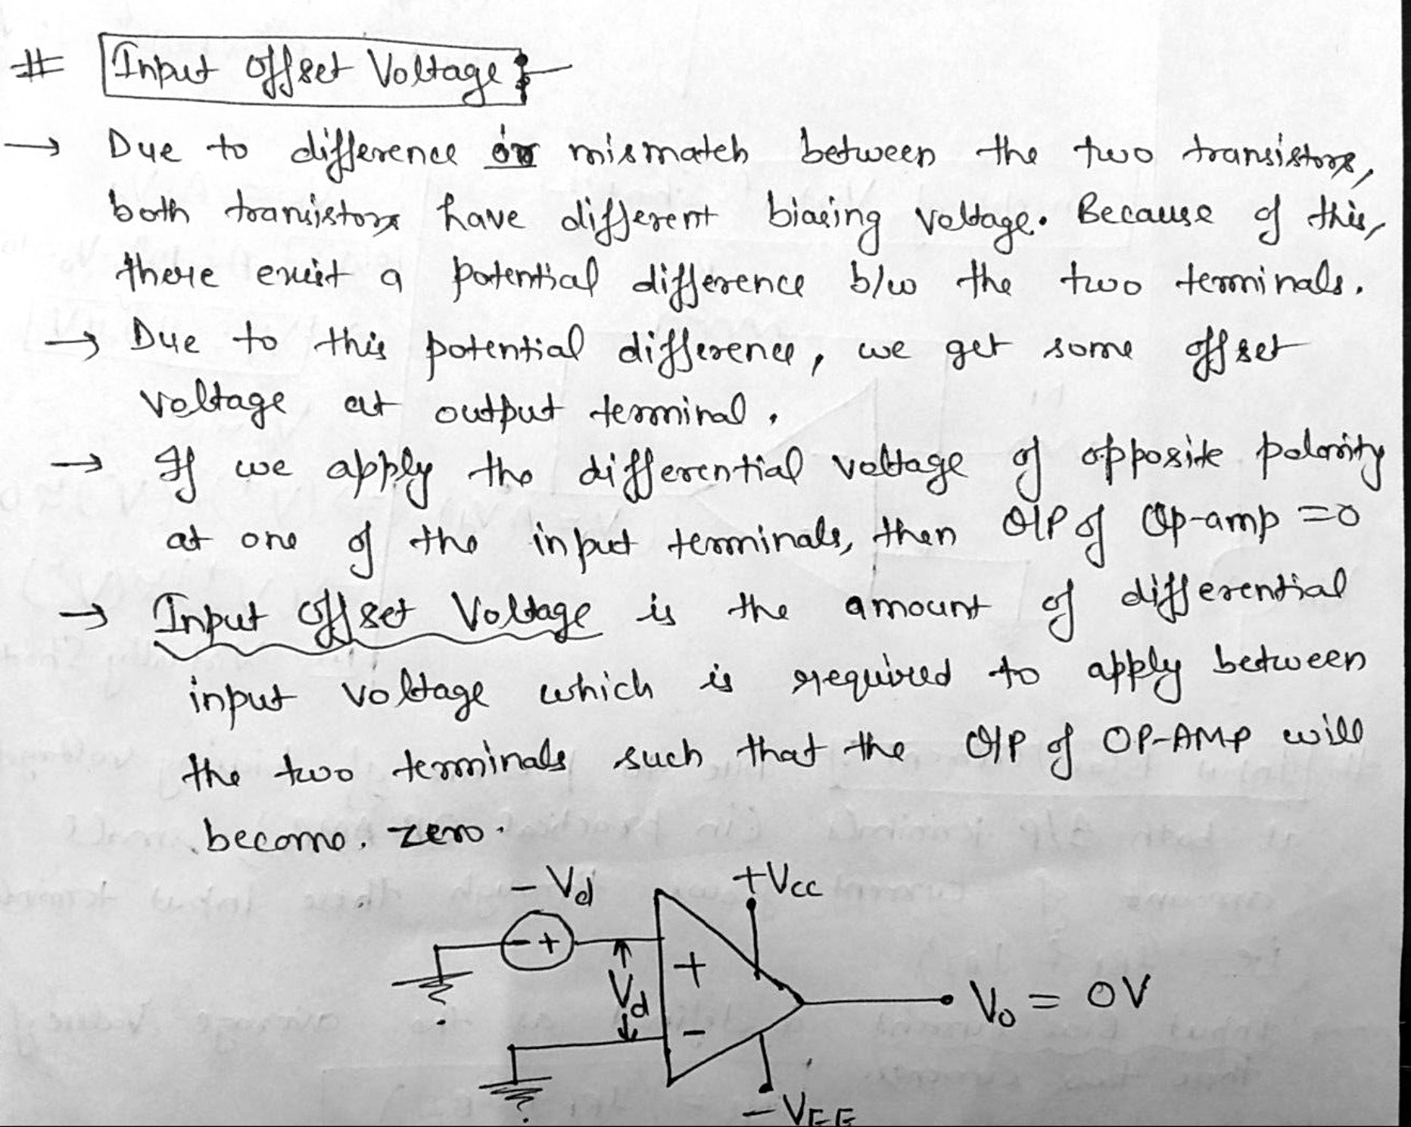
Input Offset Voltage

Slide 17
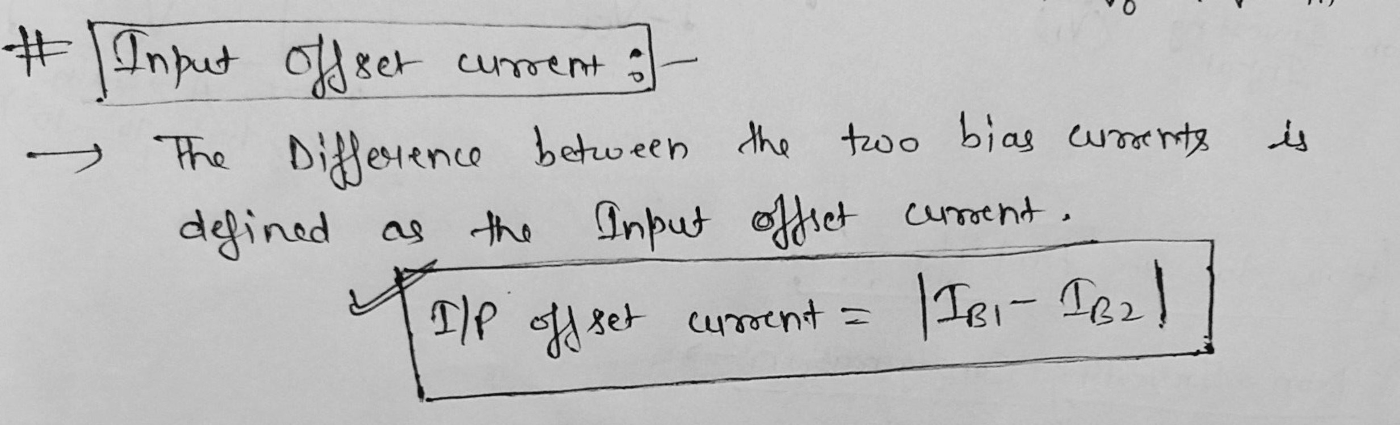
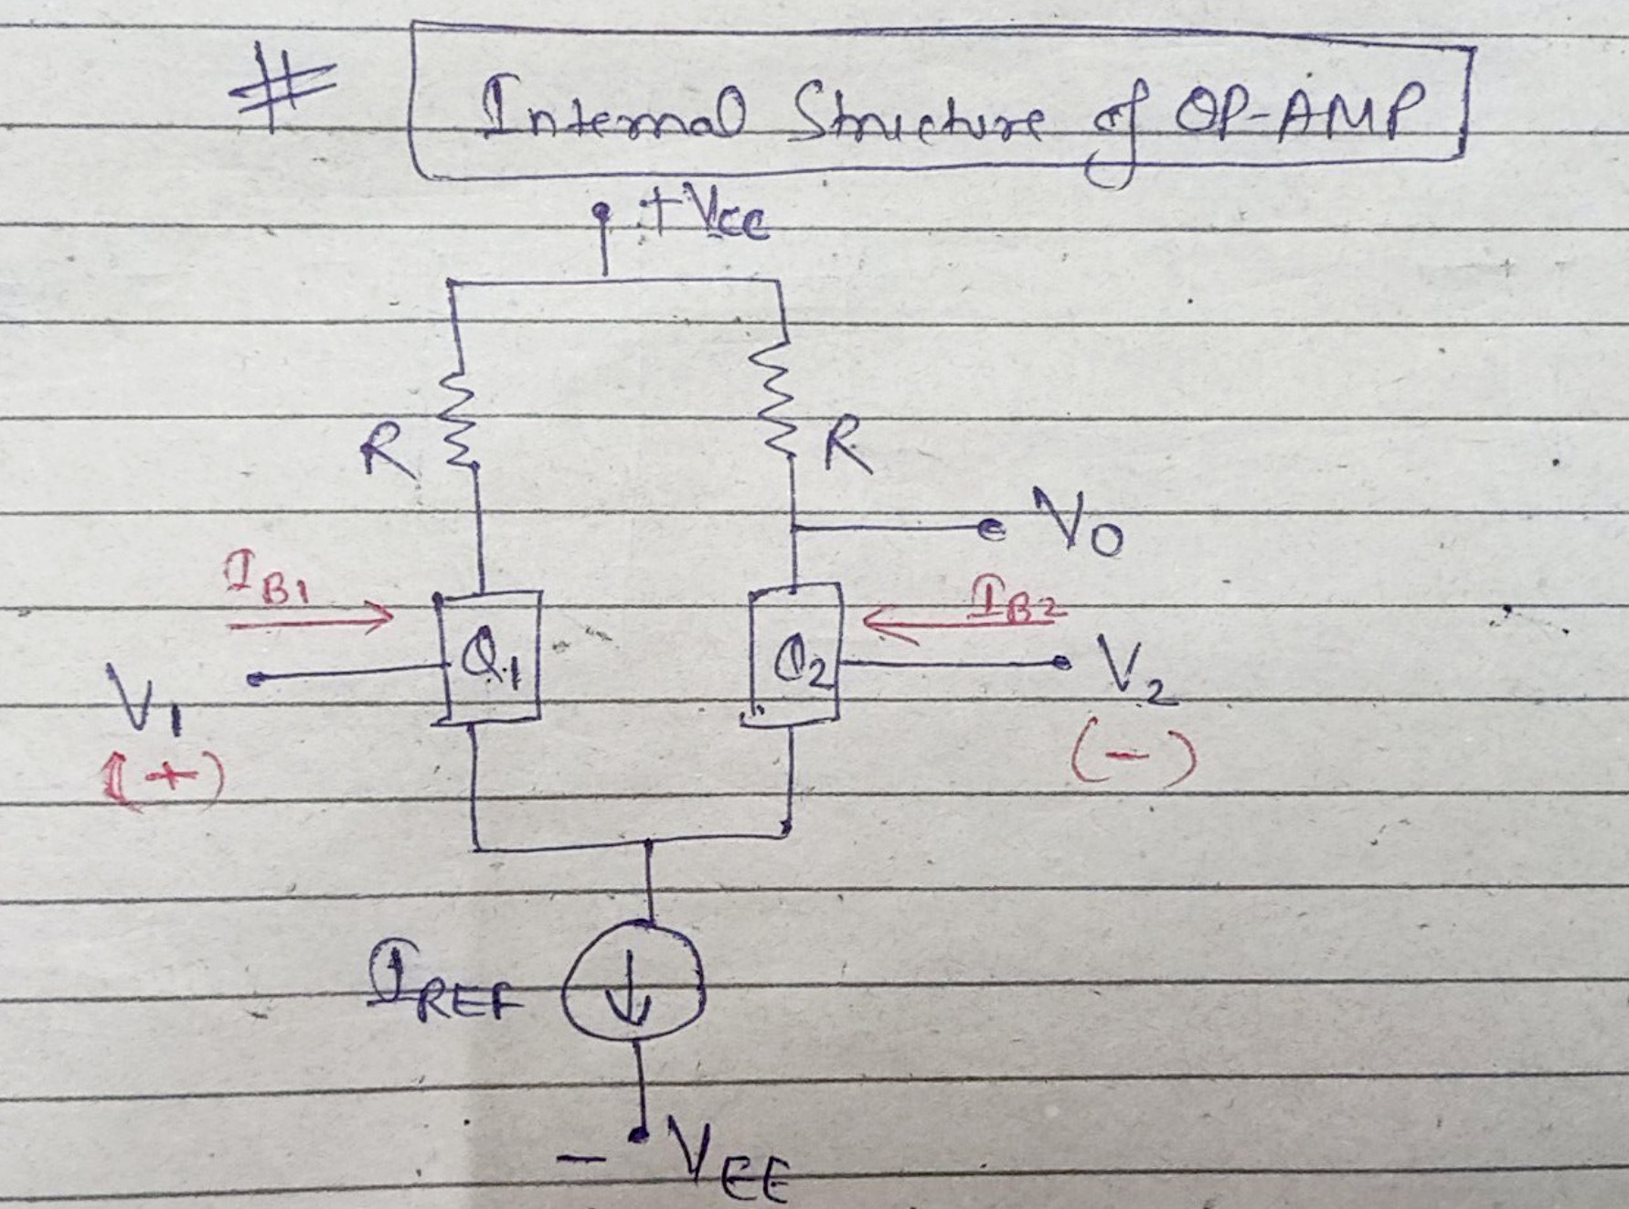
Input Offset Current

Slide 18
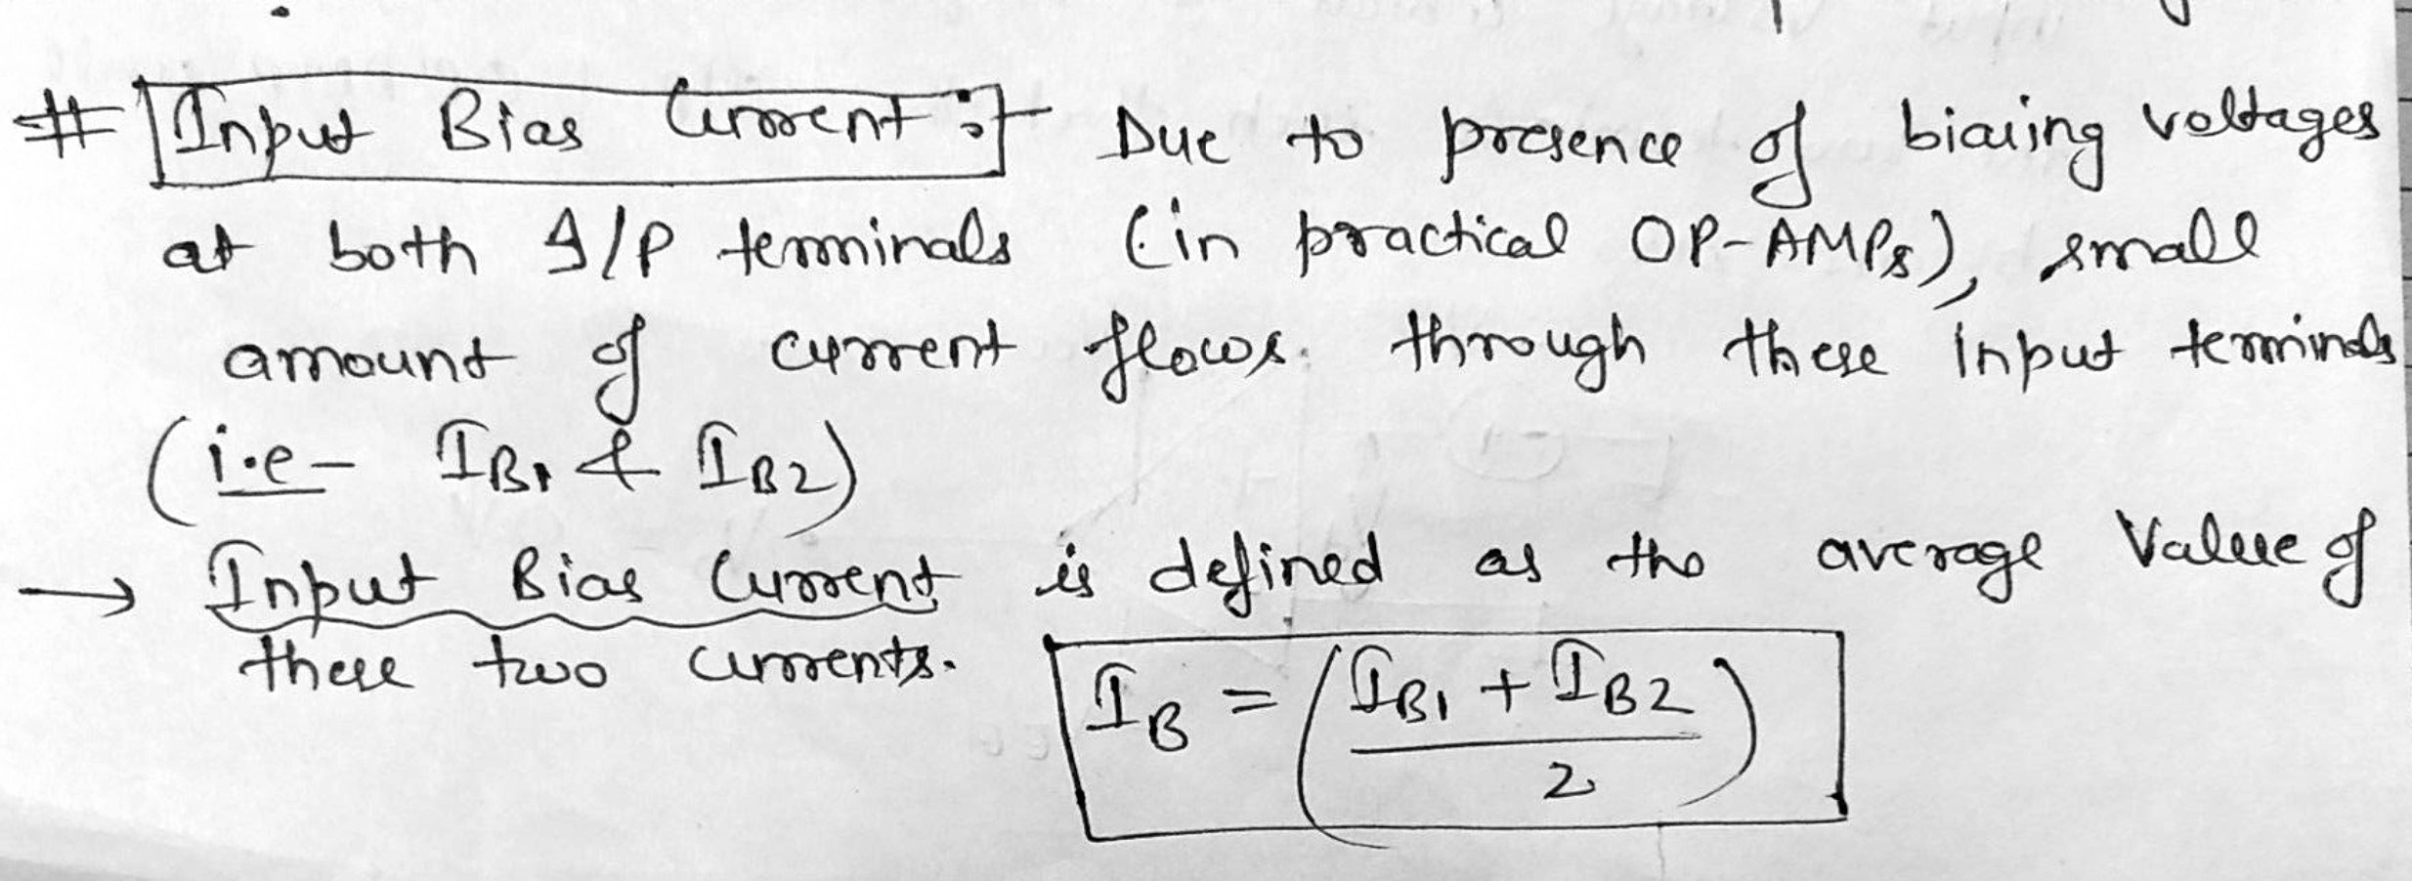
Input Bias Current

Slide 19
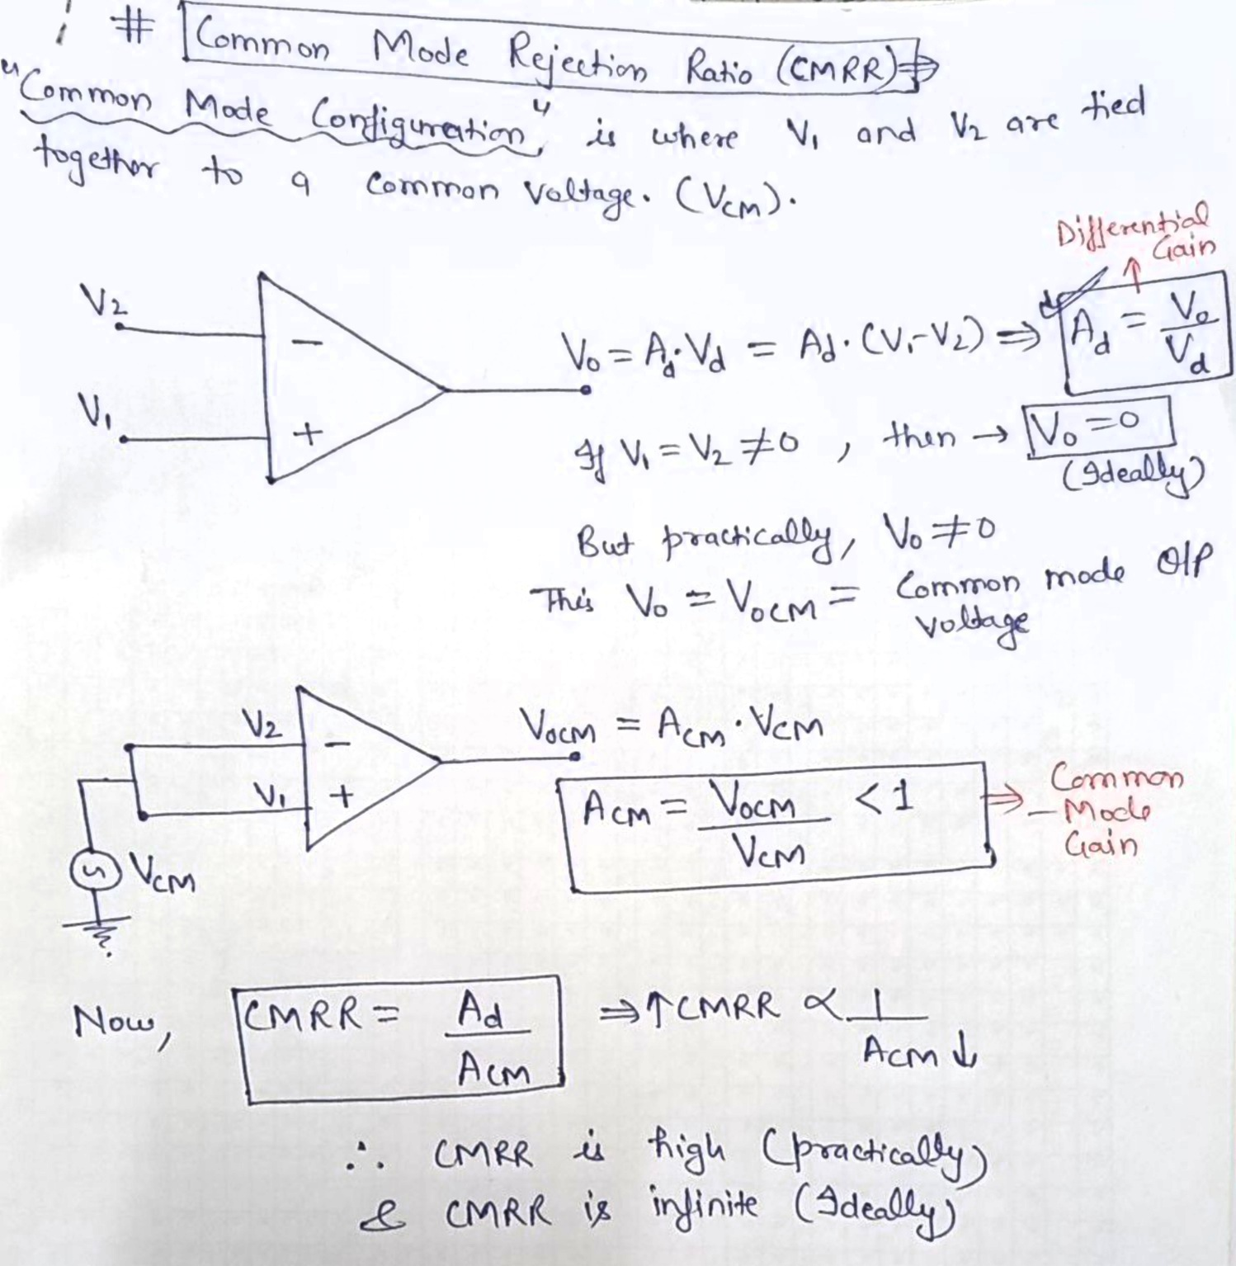
CMRR

Slide 20
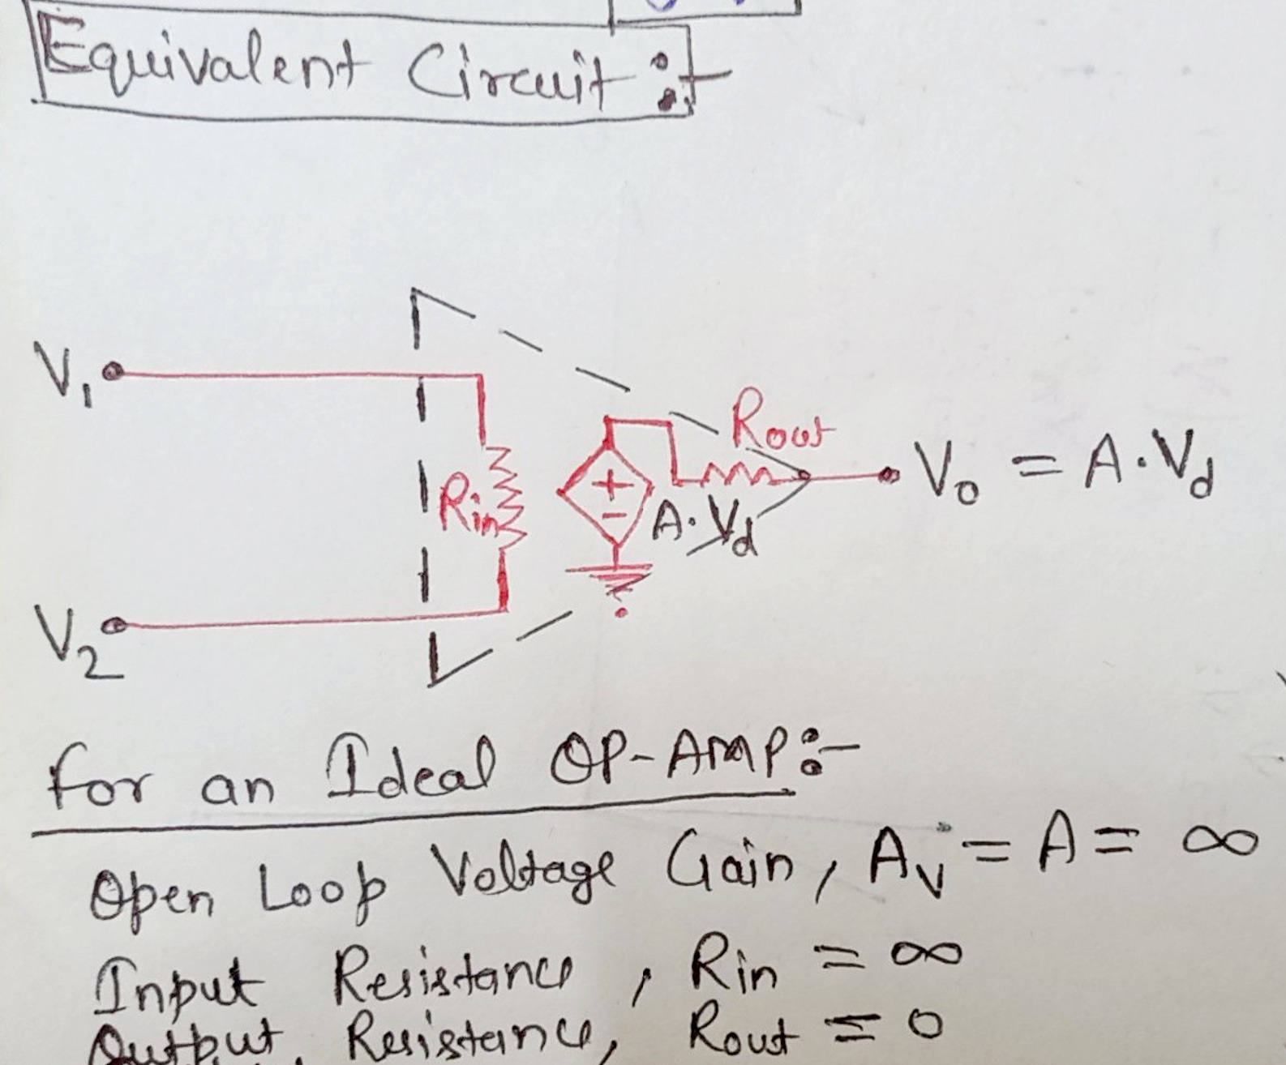
Operational Amplifier (CO5)

Slide 21
